Slide 1
Perception Prioritized Training of Diffusion Models
Jooyoung Choi, Jungbeom Lee, Chaehun Shin, Sungwon Kim, Hyunwoo Kim, Sungroh Yoon (CVPR2022).
Presented by Natan Kaminsky

Slide 2
Main Idea
Intuitively, some denoising time steps may be more critical than others for sample quality.
This work explores the importance of each denoising timestep during training and how it affects sample quality.
A new loss function is proposed that weights each timestep differently during training.

Slide 3
Agenda
Refresher
Previous works approach
Qualitative experiments
P2 loss
Results
Final thoughts

Slide 4
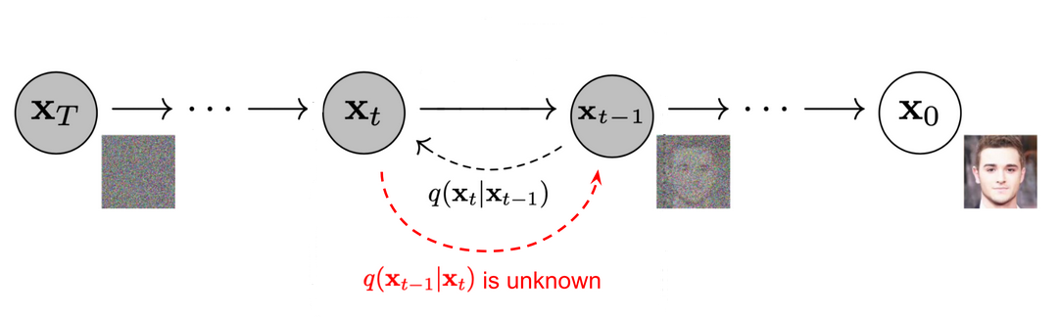
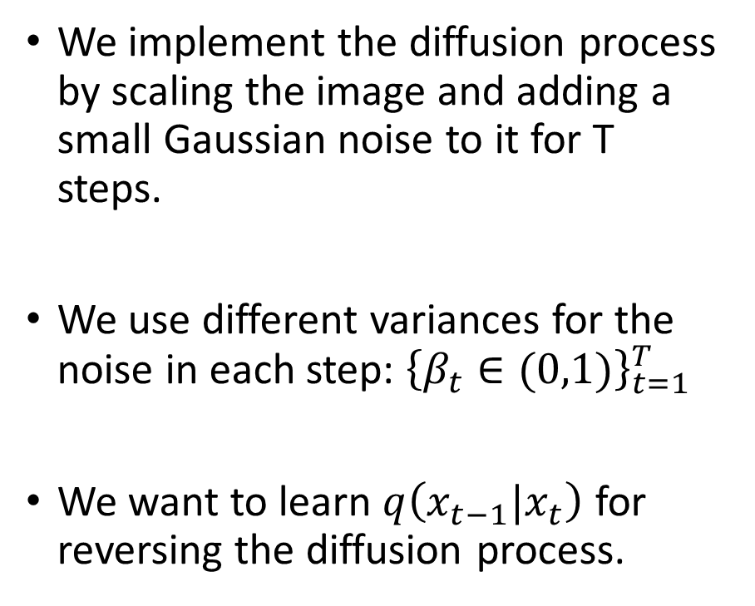
Reminder
We implement the diffusion process by scaling the image and adding a small Gaussian noise to it for T steps.
We use different variances for the noise in each step: ${\left\{β_{t}∈(0,1)\right\}}_{t=1}^{T}$
We want to learn $q\left(x_{t−1}|x_{t}\right)$ for reversing the diffusion process.
From Ho et al. 2020

Slide 5
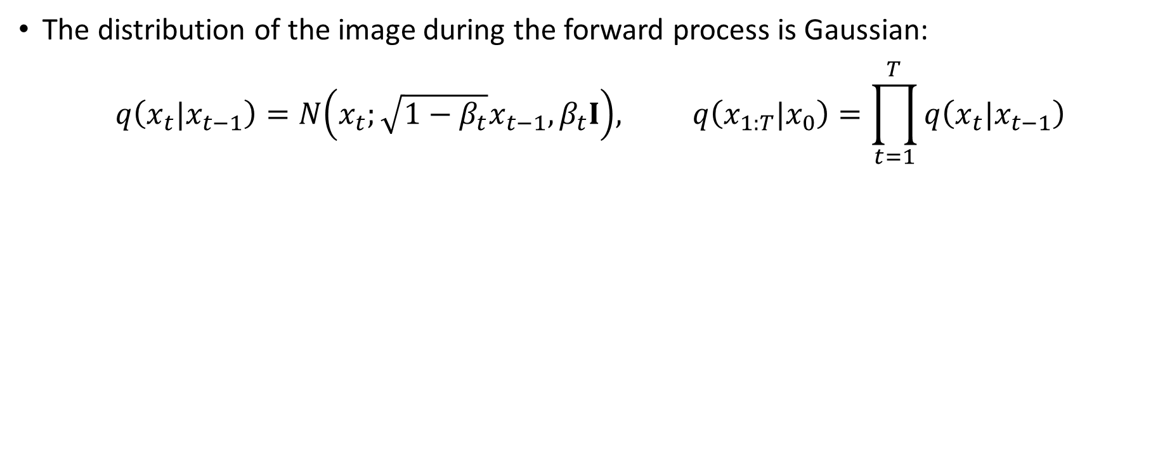
Reminder
The distribution of the image during the forward process is Gaussian:
$$q\left(x_{t}|x_{t−1}\right)=N\left(x_{t};\sqrt{1−β_{t}}x_{t−1},β_{t}I\right), q\left(x_{1:T}|x_{0}\right)=\prod_{t=1}^{T}{q\left(x_{t}|x_{t−1}\right)}$$
We saw that for $α_{t}≔\prod_{s=1}^{t}{\left(1−β_{s}\right)}⇒ x_{t}=\sqrt{α_{t}}x_{0}+\sqrt{1−α_{t}}ε_{t}$,${ ε}_{t}\sim N(0,I)$
Therefore, $q\left(x_{t}|x_{0}\right)=N\left(x_{t};\sqrt{α_{t}}x_{0}\text{, }\sqrt{1−α_{t}}I\right)$
For a small enough $β_{t}$, $q\left(x_{t−1}|x_{t}\right)$can be modeled as a Gaussian:
$$q\left(x_{t−1}|x_{t}\right)=N\left(x_{t−1};μ_{θ}\left(x_{t},t\right),∑_{θ}\left(x_{t},t\right)\right)$$
Notes:
Small enough beta = we saw as intuition that when we use bayes q(x_t|x_t-1) is gaussian that’s close to delta because beta is small multiplied by relatively small q(x_t-1)/q(x_t) therefore its approximately a gaussian. A formal proof can be found in Feller, W. On the theory of stochastic processes, with particular reference to applications. In Proceedings of the [First] Berkeley Symposium on Mathematical Statisticsand Probability. The Regents of the University of California, 1949.

Slide 6
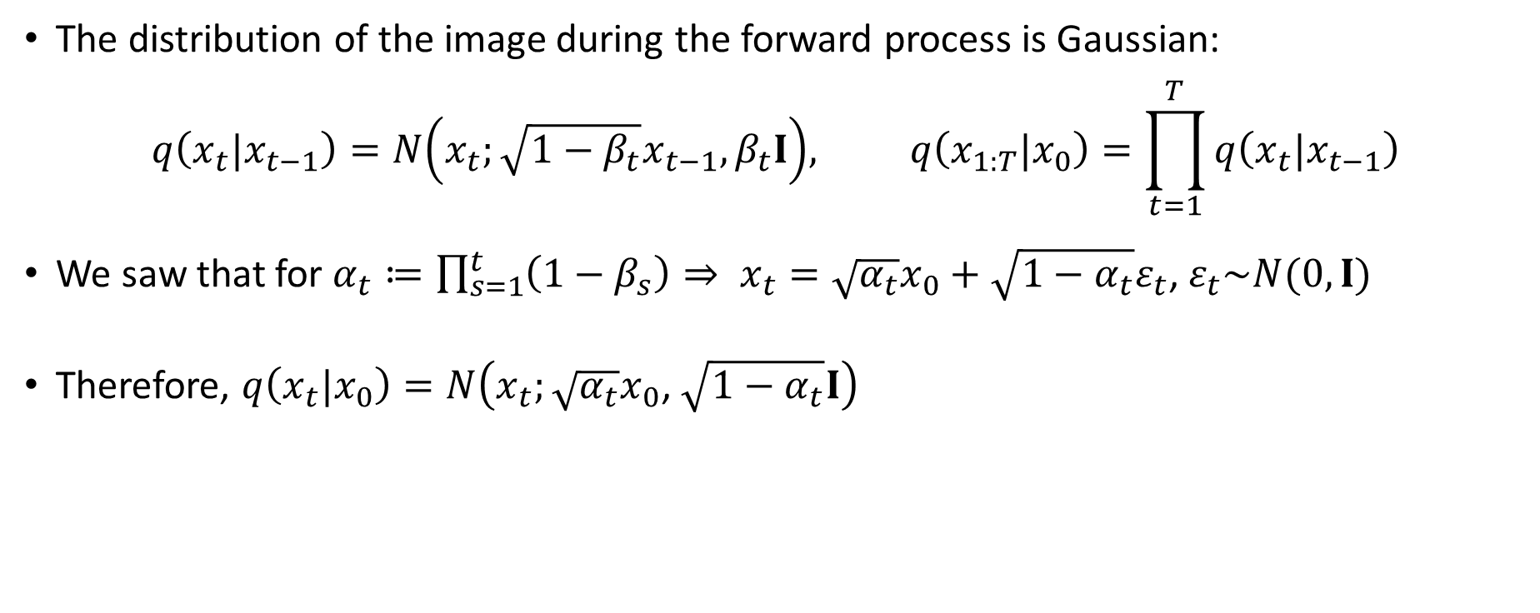
Reminder
The distribution of the image during the forward process is Gaussian:
$$q\left(x_{t}|x_{t−1}\right)=N\left(x_{t};\sqrt{1−β_{t}}x_{t−1},β_{t}I\right), q\left(x_{1:T}|x_{0}\right)=\prod_{t=1}^{T}{q\left(x_{t}|x_{t−1}\right)}$$
We saw that for $α_{t}≔\prod_{s=1}^{t}{\left(1−β_{s}\right)}⇒ x_{t}=\sqrt{α_{t}}x_{0}+\sqrt{1−α_{t}}ε_{t}$,${ ε}_{t}\sim N(0,I)$
Therefore, $q\left(x_{t}|x_{0}\right)=N\left(x_{t};\sqrt{α_{t}}x_{0}\text{, }\sqrt{1−α_{t}}I\right)$
For a small enough $β_{t}$, $q\left(x_{t−1}|x_{t}\right)$can be modeled as a Gaussian:
$$q\left(x_{t−1}|x_{t}\right)=N\left(x_{t−1};μ_{θ}\left(x_{t},t\right),∑_{θ}\left(x_{t},t\right)\right)$$
Notes:
Small enough beta = we saw as intuition that when we use bayes q(x_t|x_t-1) is gaussian that’s close to delta because beta is small multiplied by relatively small q(x_t-1)/q(x_t) therefore its approximately a gaussian. A formal proof can be found in Feller, W. On the theory of stochastic processes, with particular reference to applications. In Proceedings of the [First] Berkeley Symposium on Mathematical Statisticsand Probability. The Regents of the University of California, 1949.

Slide 7
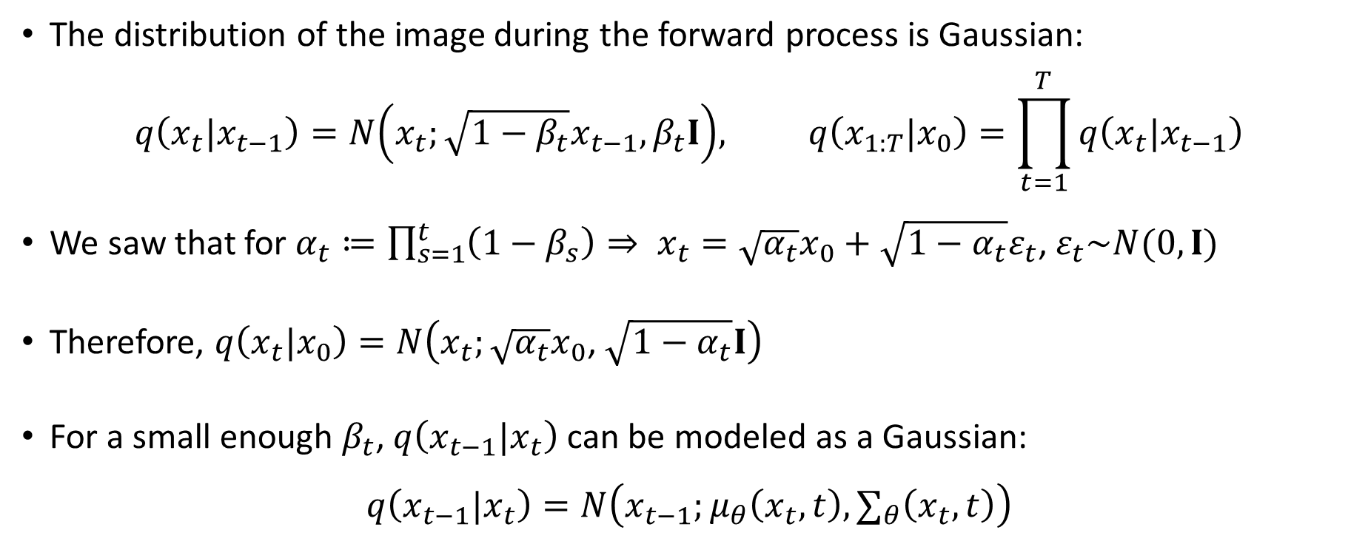
Reminder
The distribution of the image during the forward process is Gaussian:
$$q\left(x_{t}|x_{t−1}\right)=N\left(x_{t};\sqrt{1−β_{t}}x_{t−1},β_{t}I\right), q\left(x_{1:T}|x_{0}\right)=\prod_{t=1}^{T}{q\left(x_{t}|x_{t−1}\right)}$$
We saw that for $α_{t}≔\prod_{s=1}^{t}{\left(1−β_{s}\right)}⇒ x_{t}=\sqrt{α_{t}}x_{0}+\sqrt{1−α_{t}}ε_{t}$,${ ε}_{t}\sim N(0,I)$
Therefore, $q\left(x_{t}|x_{0}\right)=N\left(x_{t};\sqrt{α_{t}}x_{0}\text{, }\sqrt{1−α_{t}}I\right)$
For a small enough $β_{t}$, $q\left(x_{t−1}|x_{t}\right)$can be modeled as a Gaussian:
$$q\left(x_{t−1}|x_{t}\right)=N\left(x_{t−1};μ_{θ}\left(x_{t},t\right),∑_{θ}\left(x_{t},t\right)\right)$$
Notes:
Small enough beta = we saw as intuition that when we use bayes q(x_t|x_t-1) is gaussian that’s close to delta because beta is small multiplied by relatively small q(x_t-1)/q(x_t) therefore its approximately a gaussian. A formal proof can be found in Feller, W. On the theory of stochastic processes, with particular reference to applications. In Proceedings of the [First] Berkeley Symposium on Mathematical Statisticsand Probability. The Regents of the University of California, 1949.

Slide 8
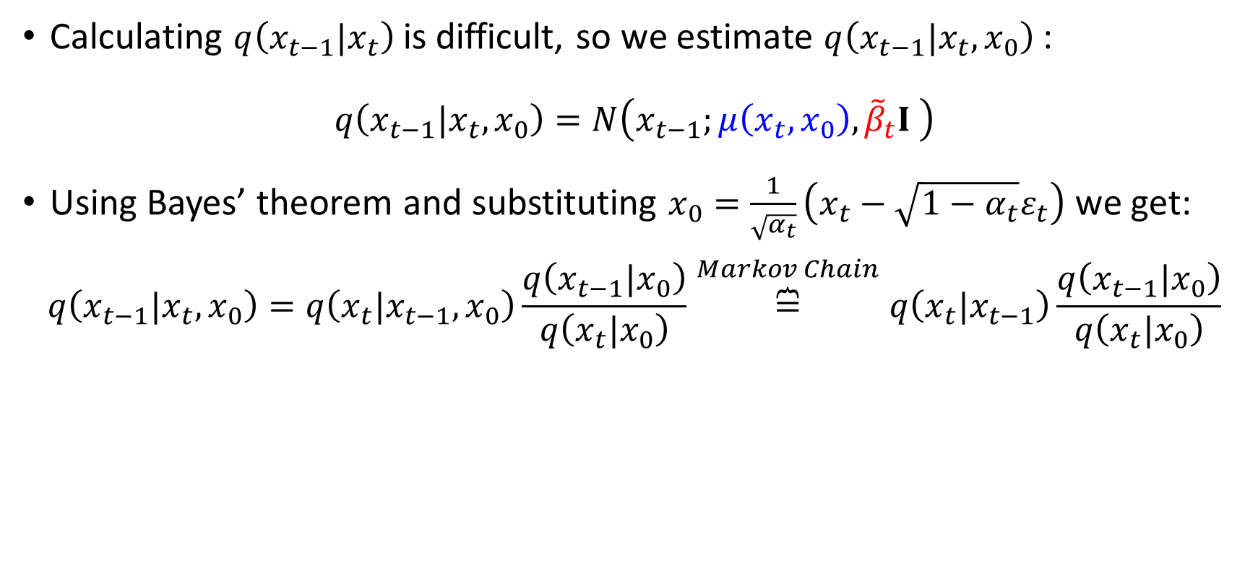
Reminder
Calculating $q\left(x_{t−1}|x_{t}\right)$is difficult, so we estimate $q\left(x_{t−1}|x_{t},x_{0}\right)$:
$$q\left(x_{t−1}|x_{t},x_{0}\right)=N\left(x_{t−1};μ\left(x_{t},x_{0}\right),{\tilde{β}}_{t}I \right)$$
Using Bayes’ theorem and substituting $x_{0}=\frac{1}{\sqrt{α_{t}}}\left(x_{t}−\sqrt{1−α_{t}}ε_{t}\right)$ we get:
$$q\left(x_{t−1}|x_{t},x_{0}\right)=q\left(x_{t}|x_{t−1},x_{0}\right)\frac{q\left(x_{t−1}|x_{0}\right)}{q\left(x_{t}|x_{0}\right)}\overset{Markov Chain}{\overbrace{=}}q\left(x_{t}|x_{t−1}\right)\frac{q\left(x_{t−1}|x_{0}\right)}{q\left(x_{t}|x_{0}\right)}$$
$$=N\left(x_{t−1};\frac{1}{\sqrt{{1−β}_{t}}}\left(x_{t}−\frac{β_{t}}{\sqrt{1−α_{t}}}ε_{t}\right)\text{, }\frac{1−α_{t−1}}{1−α_{t}}β_{t}I\right)$$

Slide 9
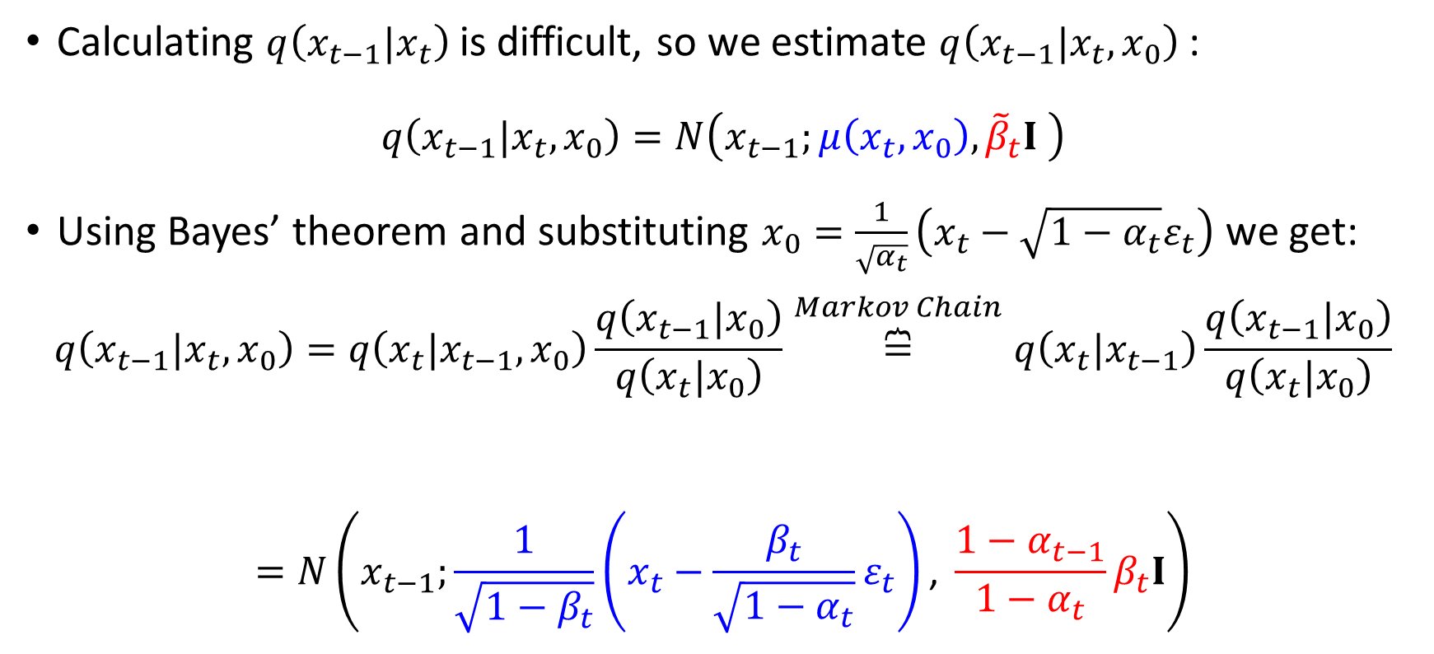
Reminder
Calculating $q\left(x_{t−1}|x_{t}\right)$is difficult, so we estimate $q\left(x_{t−1}|x_{t},x_{0}\right)$:
$$q\left(x_{t−1}|x_{t},x_{0}\right)=N\left(x_{t−1};μ\left(x_{t},x_{0}\right),{\tilde{β}}_{t}I \right)$$
Using Bayes’ theorem and substituting $x_{0}=\frac{1}{\sqrt{α_{t}}}\left(x_{t}−\sqrt{1−α_{t}}ε_{t}\right)$ we get:
$$q\left(x_{t−1}|x_{t},x_{0}\right)=q\left(x_{t}|x_{t−1},x_{0}\right)\frac{q\left(x_{t−1}|x_{0}\right)}{q\left(x_{t}|x_{0}\right)}\overset{Markov Chain}{\overbrace{=}}q\left(x_{t}|x_{t−1}\right)\frac{q\left(x_{t−1}|x_{0}\right)}{q\left(x_{t}|x_{0}\right)}$$
$$=N\left(x_{t−1};\frac{1}{\sqrt{{1−β}_{t}}}\left(x_{t}−\frac{β_{t}}{\sqrt{1−α_{t}}}ε_{t}\right)\text{, }\frac{1−α_{t−1}}{1−α_{t}}β_{t}I\right)$$
Gaussian
Gaussian
Gaussian

Slide 10
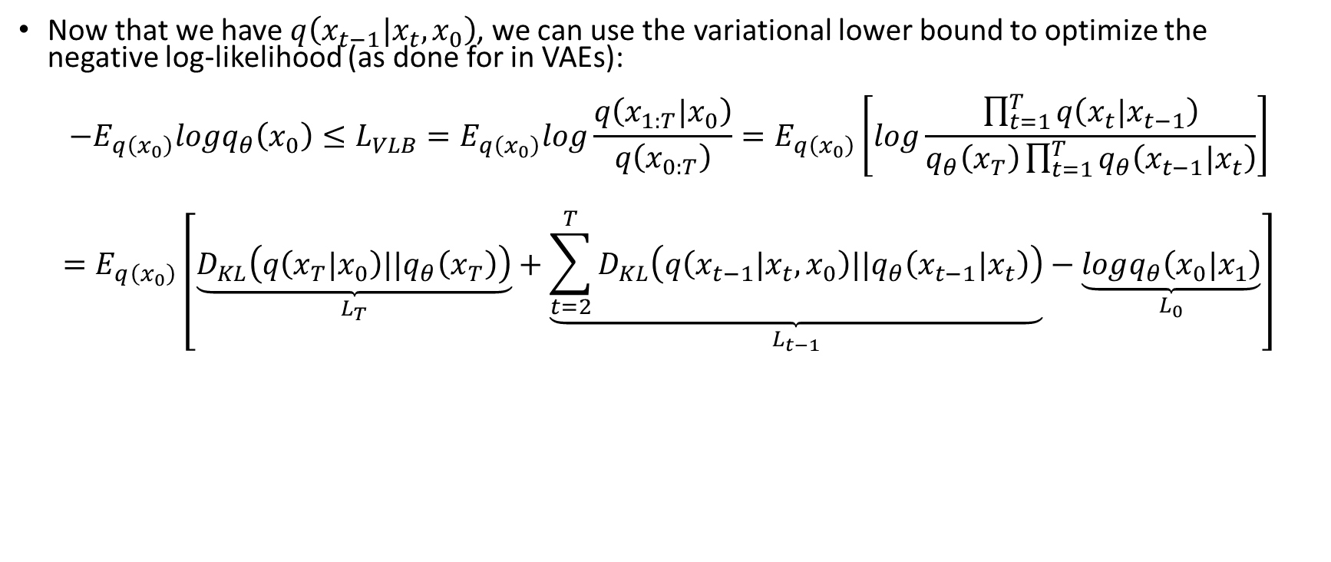
Reminder
Now that we have $q\left(x_{t−1}|x_{t},x_{0}\right)$, we can use the variational lower bound to optimize the negative log-likelihood (as done for in VAEs):
$$−E_{q\left(x_{0}\right)}logq_{θ}\left(x_{0}\right)≤L_{VLB}=E_{q\left(x_{0}\right)}log\frac{q\left(x_{1:T}|x_{0}\right)}{q\left(x_{0:T}\right)}=E_{q\left(x_{0}\right)}\left[log\frac{\prod_{t=1}^{T}{q\left(x_{t}|x_{t−1}\right)}}{q_{θ}\left(x_{T}\right)\prod_{t=1}^{T}{q_{θ}\left(x_{t−1}|x_{t}\right)}}\right]$$
$$=E_{q\left(x_{0}\right)}\left[\underset{L_{T}}{\underbrace{D_{KL}\left(q\left(x_{T}|x_{0}\right)||q_{θ}\left(x_{T}\right)\right)}}+\underset{L_{t−1}}{\underbrace{\sum_{t=2}^{T}{D_{KL}\left(q\left(x_{t−1}|{x_{t},x}_{0}\right)||q_{θ}\left(x_{t−1}|x_{t}\right)\right)}}}−\underset{L_{0}}{\underbrace{logq_{θ}\left(x_{0}|x_{1}\right)}}\right]=\sum_{t=2}^{T}{E_{x_{0},ε}\left[\frac{1}{2β_{t}}{\left\|\tilde{μ_{t}}\left(x_{t},t\right)−μ_{θ}\left(x_{t},t\right)\right\|}^{2}\right]}$$
Notes:
1. L_T is zero because its a gaussian regardless of x_0. L_0 can either be ignored or handled by training a separate network for it. For L_i we know the closed form of KL for 2 gaussians.
2. D_KL formula is for 2 multivariate Gaussians N1,N2 of dimension k.
3. In Ho et al we assume that sigma_theta is a diagonal matrix (identity * beta)

Slide 11
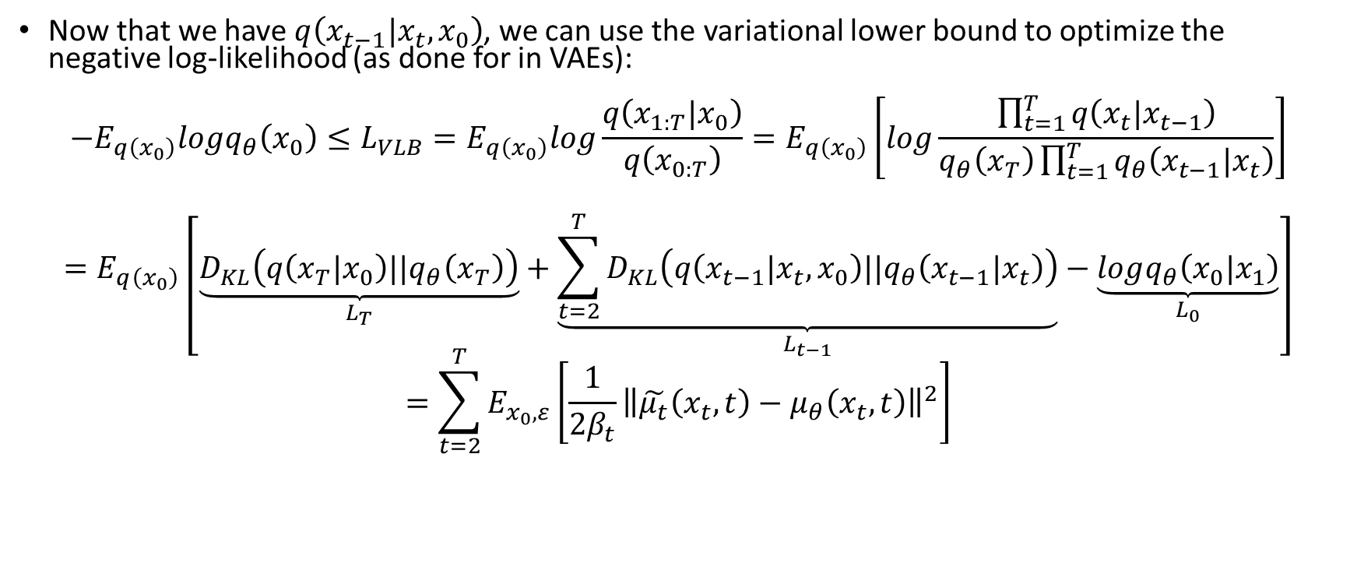
Reminder
Now that we have $q\left(x_{t−1}|x_{t},x_{0}\right)$, we can use the variational lower bound to optimize the negative log-likelihood (as done for in VAEs):
$$−E_{q\left(x_{0}\right)}logq_{θ}\left(x_{0}\right)≤L_{VLB}=E_{q\left(x_{0}\right)}log\frac{q\left(x_{1:T}|x_{0}\right)}{q\left(x_{0:T}\right)}=E_{q\left(x_{0}\right)}\left[log\frac{\prod_{t=1}^{T}{q\left(x_{t}|x_{t−1}\right)}}{q_{θ}\left(x_{T}\right)\prod_{t=1}^{T}{q_{θ}\left(x_{t−1}|x_{t}\right)}}\right]$$
$$=E_{q\left(x_{0}\right)}\left[\underset{L_{T}}{\underbrace{D_{KL}\left(q\left(x_{T}|x_{0}\right)||q_{θ}\left(x_{T}\right)\right)}}+\underset{L_{t−1}}{\underbrace{\sum_{t=2}^{T}{D_{KL}\left(q\left(x_{t−1}|{x_{t},x}_{0}\right)||q_{θ}\left(x_{t−1}|x_{t}\right)\right)}}}−\underset{L_{0}}{\underbrace{logq_{θ}\left(x_{0}|x_{1}\right)}}\right]=\sum_{t=2}^{T}{E_{x_{0},ε}\left[\frac{1}{2β_{t}}{\left\|\tilde{μ_{t}}\left(x_{t},t\right)−μ_{θ}\left(x_{t},t\right)\right\|}^{2}\right]}$$
$$D_{KL}\left(N_{1}||N_{2}\right)=\frac{1}{2}\left[log\frac{\left|∑_{N_{2}}\right|}{\left|∑_{N_{1}}\right|}−k+{\left(μ_{N_{1}}−μ_{N_{2}}\right)}^{T}{∑_{N_{2}}}^{−1}\left(μ_{N_{1}}−μ_{N_{2}}\right)+tr\left\{{∑_{N_{2}}}^{−1}∑_{N_{1}}\right\}\right]$$
Notes:
1. L_T is zero because its a gaussian regardless of x_0. L_0 can either be ignored or handled by training a separate network for it. For L_i we know the closed form of KL for 2 gaussians.
2. D_KL formula is for 2 multivariate Gaussians N1,N2 of dimension k.
3. In Ho et al we assume that sigma_theta is a diagonal matrix (identity * beta)

Slide 12
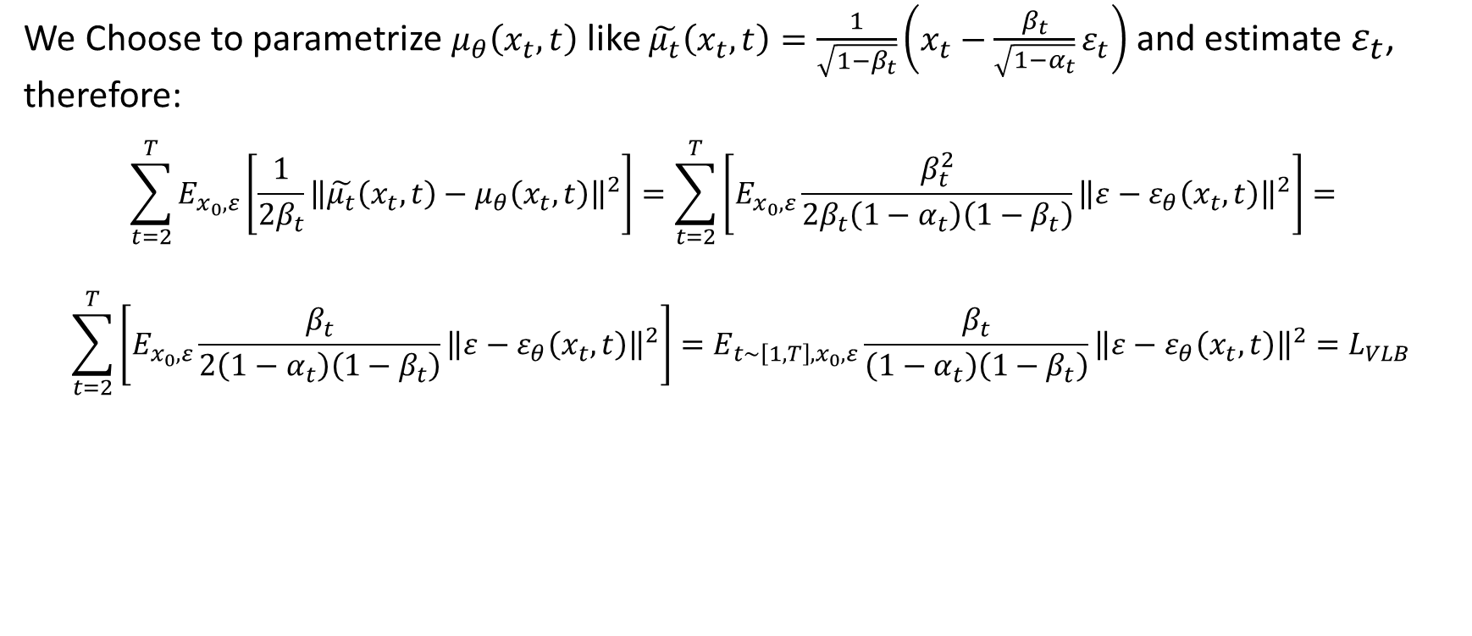
Reminder
We Choose to parametrize $μ_{θ}\left(x_{t},t\right)$ like $\tilde{μ_{t}}\left(x_{t},t\right)=\frac{1}{\sqrt{1−β_{t}}}\left(x_{t}−\frac{β_{t}}{\sqrt{1−α_{t}}}ε_{t}\right)$ and estimate $ε_{t}$, therefore:
$$\sum_{t=2}^{T}{E_{x_{0},ε}\left[\frac{1}{2β_{t}}{\left\|\tilde{μ_{t}}\left(x_{t},t\right)−μ_{θ}\left(x_{t},t\right)\right\|}^{2}\right]=\sum_{t=2}^{T}{\left[E_{x_{0},ε}\frac{β_{t}^{2}}{2β_{t}\left(1−α_{t}\right)\left(1−β_{t}\right)}{\left\|ε−ε_{θ}\left(x_{t},t\right)\right\|}^{2}\right]}= }$$
$$\sum_{t=2}^{T}{\left[E_{x_{0},ε}\frac{β_{t}}{2\left(1−α_{t}\right)\left(1−β_{t}\right)}{\left\|ε−ε_{θ}\left(x_{t},t\right)\right\|}^{2}\right]=E_{{t\sim \left[1,T\right],x}_{0},ε}\frac{β_{t}}{\left(1−α_{t}\right)\left(1−β_{t}\right)}{\left\|ε−ε_{θ}\left(x_{t},t\right)\right\|}^{2}=L_{VLB}}$$
Previous works use a slightly different objective: ${{\text{λ}}_{t}L}_{VLB}$ where ${\text{λ}}_{t}=\frac{\left(1−α_{t}\right)\left(1−β_{t}\right)}{β_{t}}$
${\text{λ}}_{t}$ cancels out the coefficient of ${\left\|ε−ε_{θ}\left(x_{t},t\right)\right\|}^{2}$

Slide 13
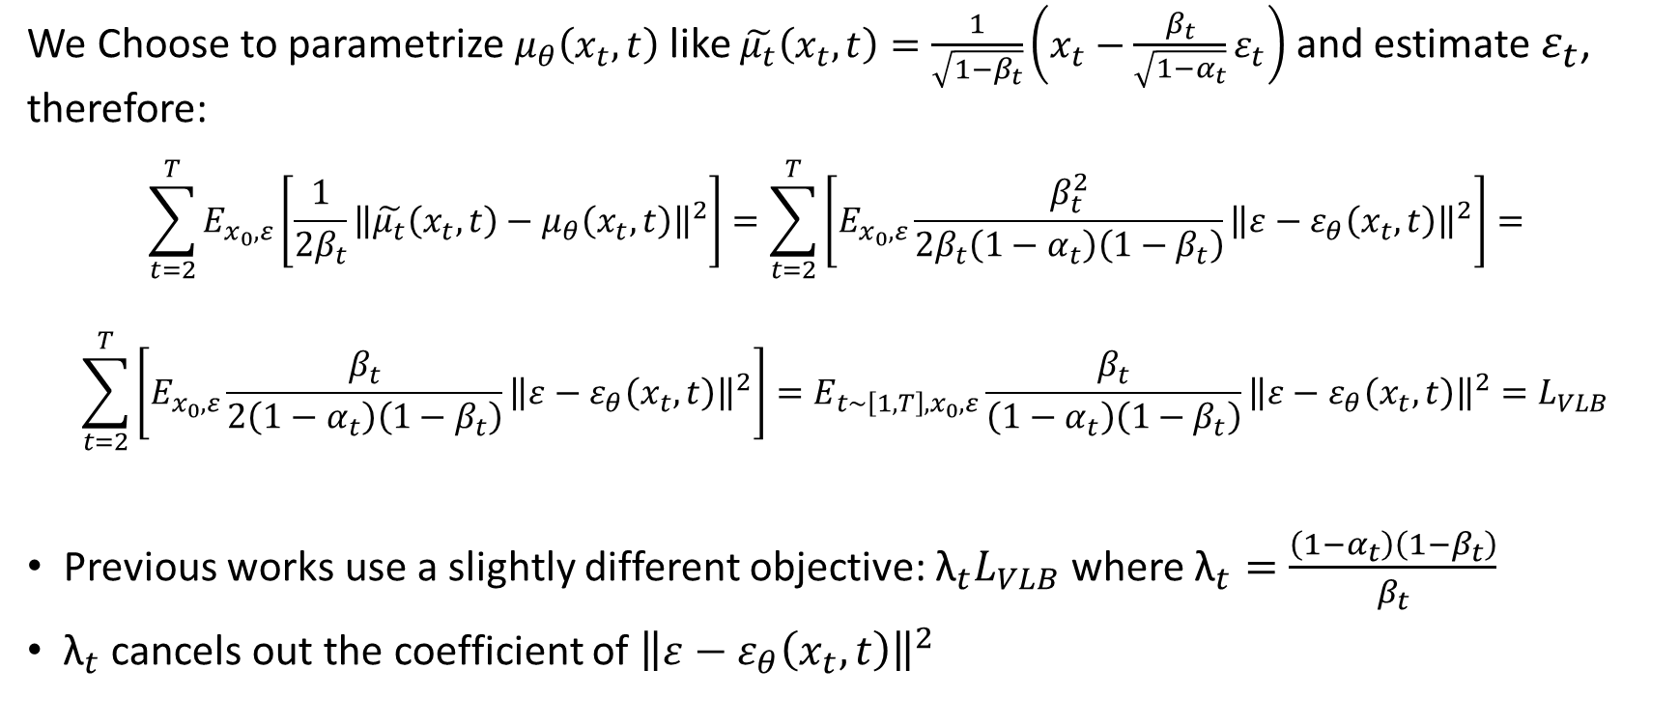
Reminder
We Choose to parametrize $μ_{θ}\left(x_{t},t\right)$ like $\tilde{μ_{t}}\left(x_{t},t\right)=\frac{1}{\sqrt{1−β_{t}}}\left(x_{t}−\frac{β_{t}}{\sqrt{1−α_{t}}}ε_{t}\right)$ and estimate $ε_{t}$, therefore:
$$\sum_{t=2}^{T}{E_{x_{0},ε}\left[\frac{1}{2β_{t}}{\left\|\tilde{μ_{t}}\left(x_{t},t\right)−μ_{θ}\left(x_{t},t\right)\right\|}^{2}\right]=\sum_{t=2}^{T}{\left[E_{x_{0},ε}\frac{β_{t}^{2}}{2β_{t}\left(1−α_{t}\right)\left(1−β_{t}\right)}{\left\|ε−ε_{θ}\left(x_{t},t\right)\right\|}^{2}\right]}= }$$
$$\sum_{t=2}^{T}{\left[E_{x_{0},ε}\frac{β_{t}}{2\left(1−α_{t}\right)\left(1−β_{t}\right)}{\left\|ε−ε_{θ}\left(x_{t},t\right)\right\|}^{2}\right]=E_{{t\sim \left[1,T\right],x}_{0},ε}\frac{β_{t}}{\left(1−α_{t}\right)\left(1−β_{t}\right)}{\left\|ε−ε_{θ}\left(x_{t},t\right)\right\|}^{2}=L_{VLB}}$$
Previous works use a slightly different objective: ${{\text{λ}}_{t}L}_{VLB}$ where ${\text{λ}}_{t}=\frac{\left(1−α_{t}\right)\left(1−β_{t}\right)}{β_{t}}$
${\text{λ}}_{t}$ cancels out the coefficient of ${\left\|ε−ε_{θ}\left(x_{t},t\right)\right\|}^{2}$

Slide 14
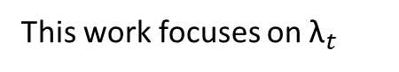
Reminder
We Choose to parametrize $μ_{θ}\left(x_{t},t\right)$ like $\tilde{μ_{t}}\left(x_{t},t\right)=\frac{1}{\sqrt{1−β_{t}}}\left(x_{t}−\frac{β_{t}}{\sqrt{1−α_{t}}}ε_{t}\right)$ and estimate $ε_{t}$, therefore:
$$\sum_{t=2}^{T}{E_{x_{0},ε}\left[\frac{1}{2β_{t}}{\left\|\tilde{μ_{t}}\left(x_{t},t\right)−μ_{θ}\left(x_{t},t\right)\right\|}^{2}\right]=\sum_{t=2}^{T}{\left[E_{x_{0},ε}\frac{β_{t}^{2}}{2β_{t}\left(1−α_{t}\right)\left(1−β_{t}\right)}{\left\|ε−ε_{θ}\left(x_{t},t\right)\right\|}^{2}\right]}= }$$
$$\sum_{t=2}^{T}{\left[E_{x_{0},ε}\frac{β_{t}}{2\left(1−α_{t}\right)\left(1−β_{t}\right)}{\left\|ε−ε_{θ}\left(x_{t},t\right)\right\|}^{2}\right]=E_{{t\sim \left[1,T\right],x}_{0},ε}\frac{β_{t}}{\left(1−α_{t}\right)\left(1−β_{t}\right)}{\left\|ε−ε_{θ}\left(x_{t},t\right)\right\|}^{2}=L_{VLB}}$$
Previous works use a slightly different objective: ${{\text{λ}}_{t}L}_{VLB}$ where ${\text{λ}}_{t}=\frac{\left(1−α_{t}\right)\left(1−β_{t}\right)}{β_{t}}$
${\text{λ}}_{t}$ cancels out the coefficient of ${\left\|ε−ε_{θ}\left(x_{t},t\right)\right\|}^{2}$
This work focuses on ${\text{λ}}_{t}$

Slide 15
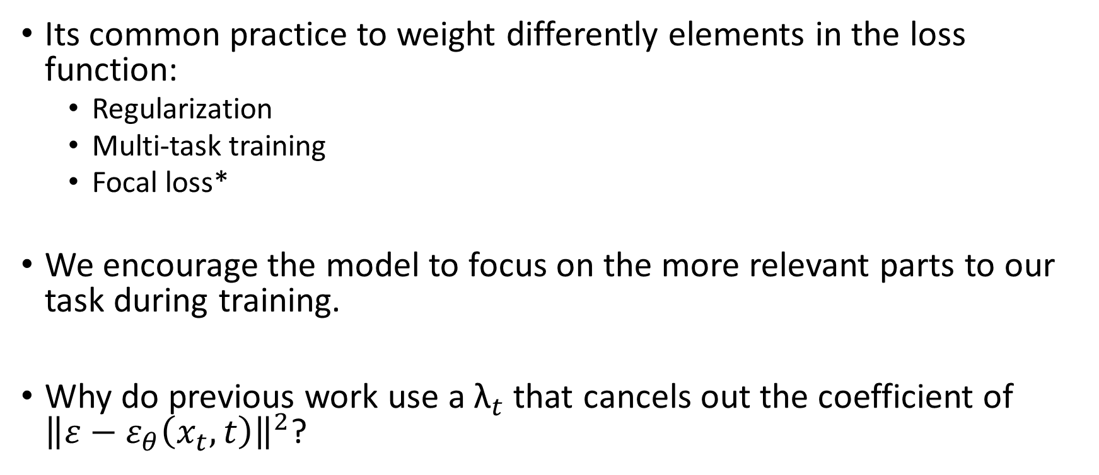
Weighting The Loss
Its common practice to weight differently elements in the loss function:
Regularization
Multi-task training
Focal loss*
We encourage the model to focus on the more relevant parts to our task during training.
Why do previous work use a ${\text{λ}}_{t}$ that cancels out the coefficient of ${\left\|ε−ε_{θ}\left(x_{t},t\right)\right\|}^{2}$?
Notes:
1. Focal loss is an implicit way to weight the data samples during training

Slide 16
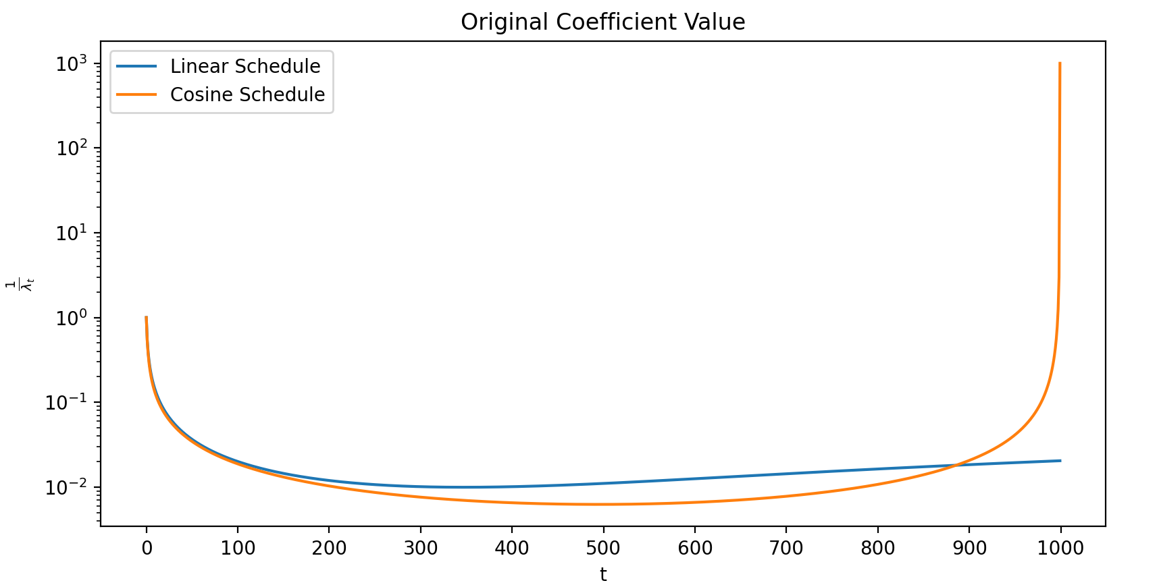
Default Weighting of Diffusion Steps
Not in paper
Notes:
1. I implemented this plot with a linear noise schedule from 1e-4 to 0.02 (same as Ho et al.)

Slide 17
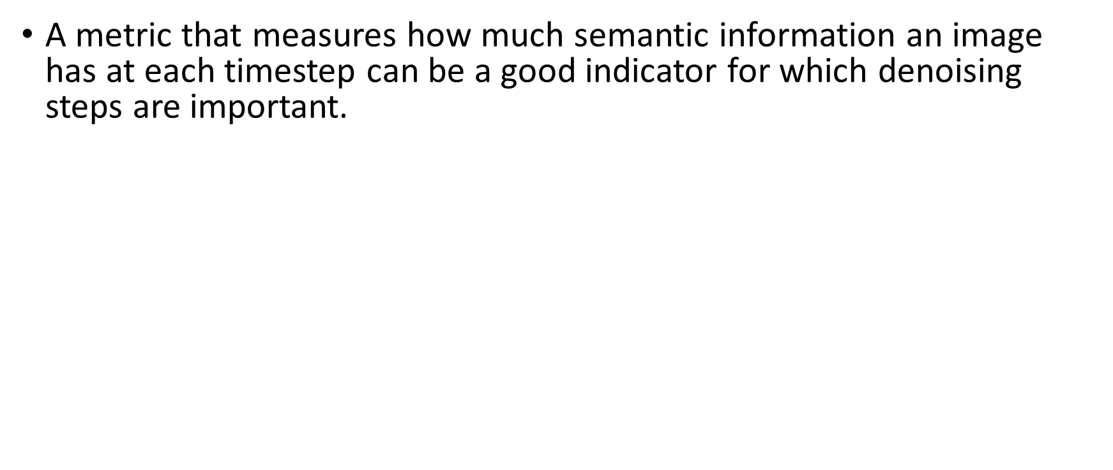
Signal to Noise Ratio
A metric that measures how much semantic information an image has at each timestep can be a good indicator for which denoising steps are important.
For $x_{t}=\sqrt{α_{t}}x_{0}+\sqrt{1−α_{t}}ε_{t}$the authors define a signal-to-noise metric:
$SNR\left(t\right)=\frac{α_{t}}{1−α_{t}}$
$SNR\left(t\right)$is a monotonic decreasing function like $α_{t}$.
Notes:
SNR is not very well defined in the image processing community. One of the common definitions in image processing for snr is the signal mean divided by the std of the noise (or all of it squared).
The authors SNR definition is accurate up to a scalar dependent on x_0 (we just take into account the current “weight” of the image compared to noise). Kingma in “variational diffusion models” use this definition as well.

Slide 18
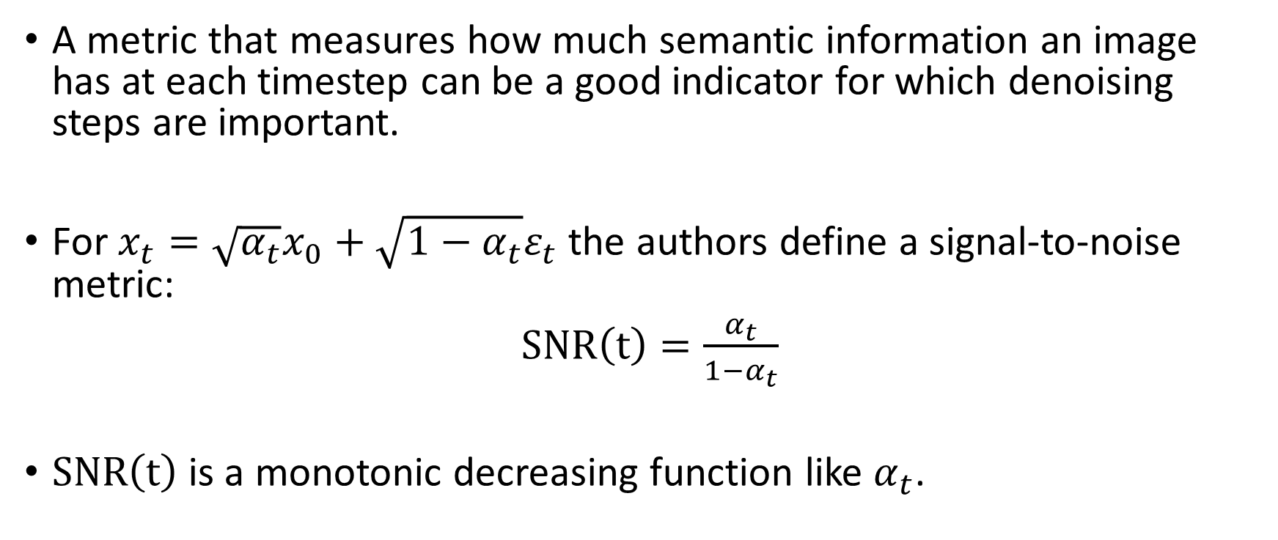
Signal to Noise Ratio
A metric that measures how much semantic information an image has at each timestep can be a good indicator for which denoising steps are important.
For $x_{t}=\sqrt{α_{t}}x_{0}+\sqrt{1−α_{t}}ε_{t}$the authors define a signal-to-noise metric:
$SNR\left(t\right)=\frac{α_{t}}{1−α_{t}}$
$SNR\left(t\right)$is a monotonic decreasing function like $α_{t}$.
Notes:
SNR is not very well defined in the image processing community. One of the common definitions in image processing for snr is the signal mean divided by the std of the noise (or all of it squared).
The authors SNR definition is accurate up to a scalar dependent on x_0 (we just take into account the current “weight” of the image compared to noise). Kingma in “variational diffusion models” use this definition as well.

Slide 19
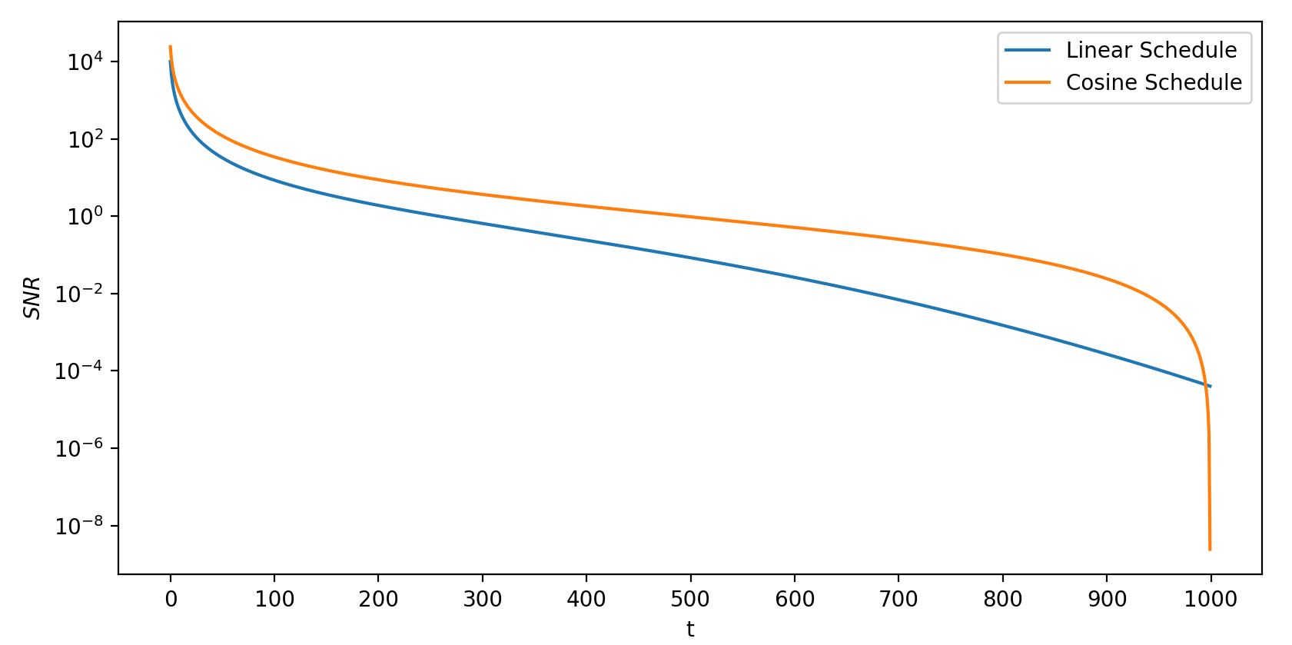
Signal to Noise Ratio

Slide 20
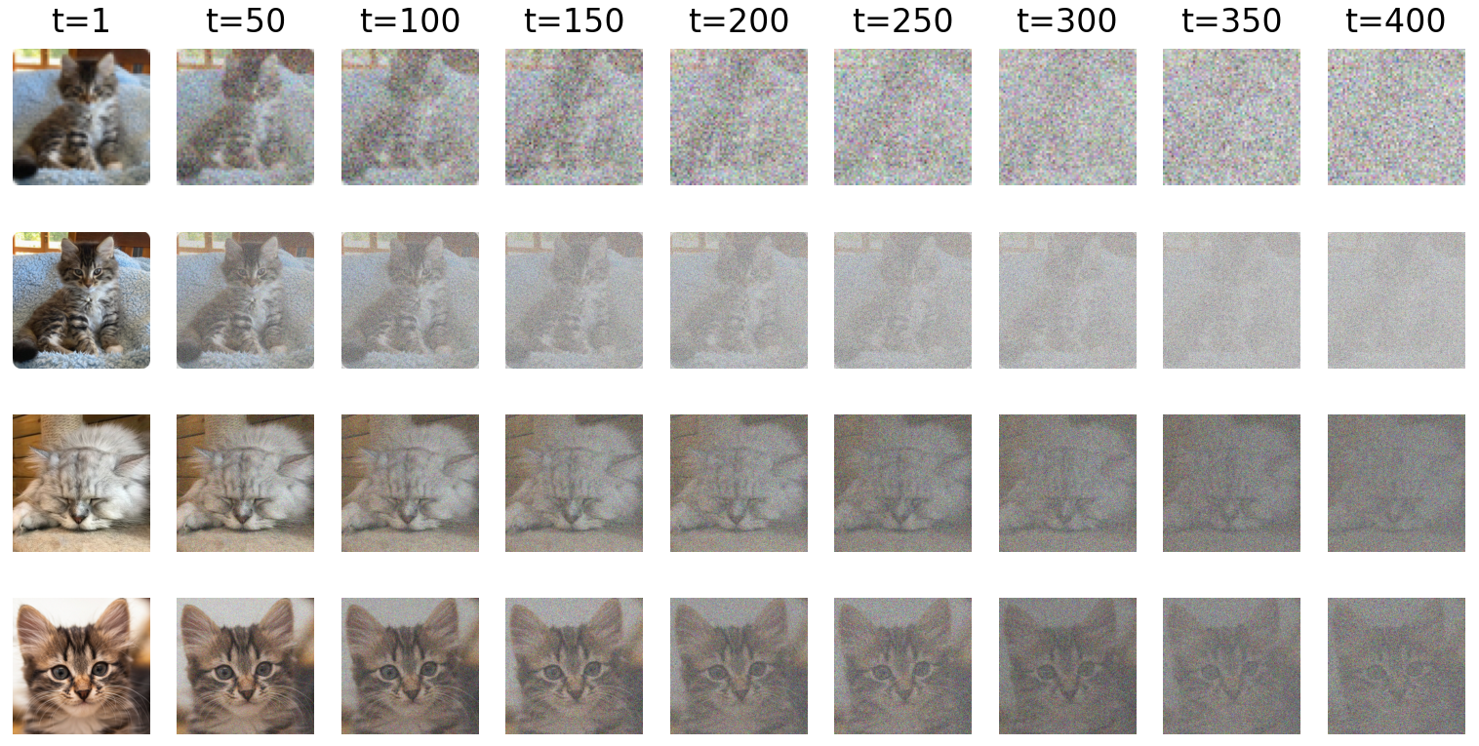

$x_{0}$ Significance
Not in paper
Notes:
Linear schedule between 1e-4 to 0.02 in 1000 steps
Top row is an image in resolution 64x64, all other rows are image in resolution 256x256

Slide 21
Noise Levels
The authors define 3 noise levels: coarse (high noise), content (medium noise) and cleanup (little noise). They hypothesize that:
They hypothesize that diffusion models learn coarse features (e.g., global color structure) at steps of small SNRs, perceptually rich contents at medium SNRs and remove remaining noise at large SNRs.
The cleanup noise level is less important for generating high quality samples.
cleanup
content
coarse
Modified image from Nichol et al. 2021
Notes:
The authors hypothesis 1 intuitively makes sense. However, Do the diffusion models necessarily learn features in this manner? Maybe they first learn granular features such as textures?
Hypothesis 2 relies on the fact that the model can easily clean the noise in these steps without a good understanding of the context of this image (by using simple rules such as “preserve lines/texture” the model does not need to know how a dog/cat/car looks like).
They perform 2 qualitative experiments to further support their intuition.

Slide 22
Noise Levels
The authors define 3 noise levels: coarse (high noise), content (medium noise) and cleanup (little noise). They hypothesize that:
Diffusion models learn coarse features (e.g., global color structure) at steps of small SNRs, perceptually rich contents at medium SNRs and remove remaining noise at large SNRs.
The cleanup noise level is less important for generating high quality samples.
cleanup
content
coarse
Modified image from Nichol et al. 2021
Notes:
The authors hypothesis 1 intuitively makes sense. However, Do the diffusion models necessarily learn features in this manner? Maybe they first learn granular features such as textures?
Hypothesis 2 relies on the fact that the model can easily clean the noise in these steps without a good understanding of the context of this image (by using simple rules such as “preserve lines/texture” the model does not need to know how a dog/cat/car looks like).
They perform 2 qualitative experiments to further support their intuition.

Slide 23
Noise Levels
The authors define 3 noise levels: coarse (high noise), content (medium noise) and cleanup (little noise). They hypothesize that:
Diffusion models learn coarse features (e.g., global color structure) at steps of small SNRs, perceptually rich contents at medium SNRs and remove remaining noise at large SNRs.
The cleanup noise level is less important for generating high quality samples.
cleanup
content
coarse
Modified image from Nichol et al. 2021
Notes:
The authors hypothesis 1 intuitively makes sense. However, Do the diffusion models necessarily learn features in this manner? Maybe they first learn granular features such as textures?
Hypothesis 2 relies on the fact that the model can easily clean the noise in these steps without a good understanding of the context of this image (by using simple rules such as “preserve lines/texture” the model does not need to know how a dog/cat/car looks like).
They perform 2 qualitative experiments to further support their intuition.

Slide 24
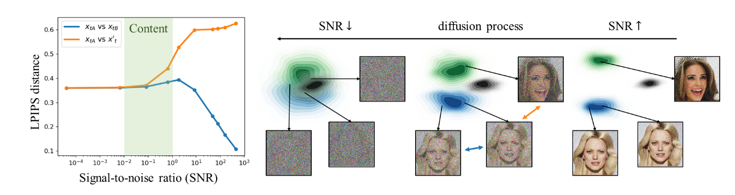
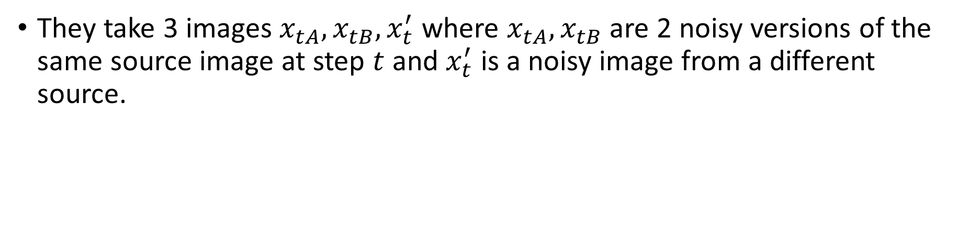
Qualitative Experiment – Hypothesis 2
From Choi et al. 2022
They take 3 images $x_{tA},x_{tB},x_{t}^{′}$ where $x_{tA},x_{tB}$ are 2 noisy versions of the same source image at step $t$ and $x_{t}^{′}$ is a noisy image from a different source.
Notes:
They measure perceptual distance with LPIPS, this metric uses the feature vectors of pretrained networks to measure how similar images are. It has been shown that this metric is more aligned with human perception than classical metrics such as SSIM/PSNR. We can see that for relatively big SNRs x_tA, x_tB are close, this indicates that a model can easily clean the noise in these steps without a good understanding of the context of this image (this is true because the model was not pretrained for denoising images or even saw images from these classes).
The plot is an average of 200 random image triplets (CelebA-HQ).
Resnet was trained to classify on imagenet, therefore if relatively early x_tA and x’_t distance become constant it means that semantically this noise level is less important.

Slide 25
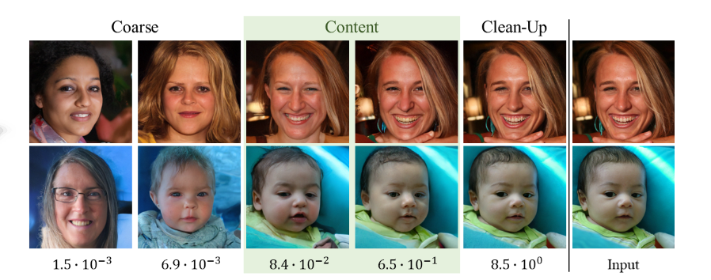
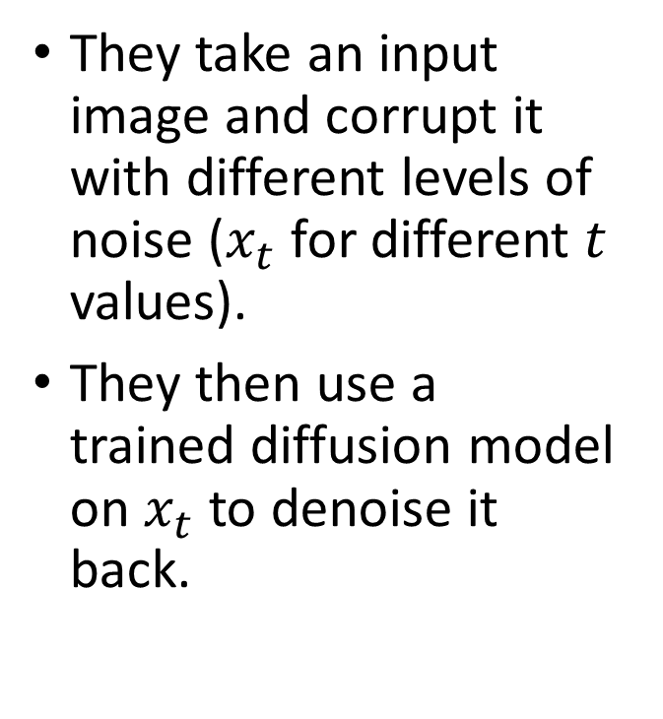
Qualitative Experiment – Hypothesis 1
They take an input image and corrupt it with different levels of noise ($x_{t}$ for different $t$ values).
They then use a trained diffusion model on $x_{t}$ to denoise it back.
Notes:
1. the lower number in the image is SNR of x_t (the noisy input to the diffusion model), the images in the columns are the final outputs of the diffusion model.

Slide 26
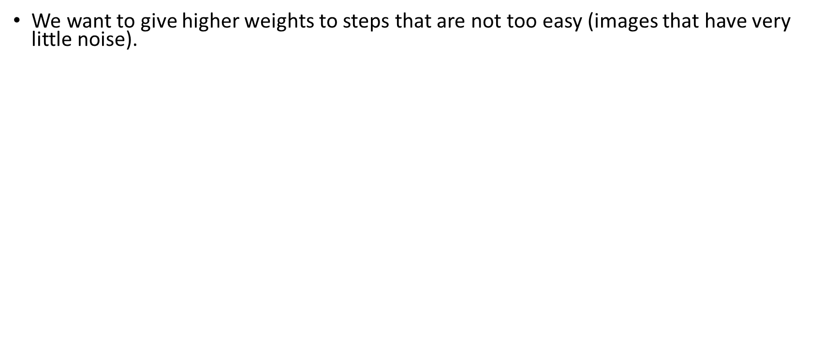
P2 Loss - Perception Prioritized Weighting
We want to give higher weights to steps that are not too easy (images that have very little noise).
The authors suggest a new weighting scheme:
$$λ_{t}^{′}=\frac{{\text{λ}}_{t}}{{\left(k+SNR\left(t\right)\right)}^{γ}}$$
$γ$ is a hyperparameter that controls how much we down-weight the cleanup noise level.
$k$ is a hyperparameter that prevents exploding weights for extremely small SNRs.
For $γ=0$ we get the regular case $λ_{t}^{′}={\text{λ}}_{t}$

Slide 27
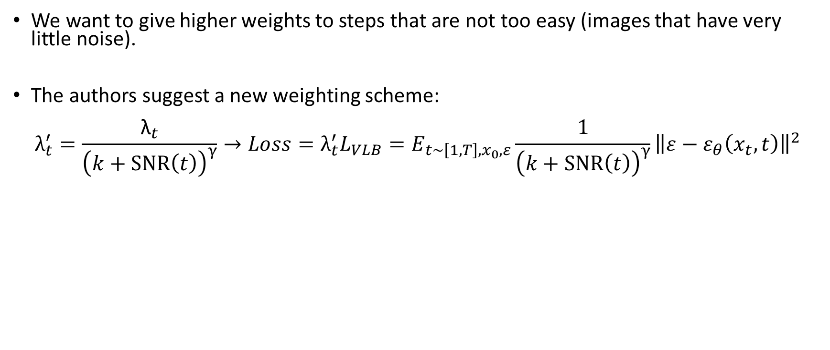
P2 Loss - Perception Prioritized Weighting
We want to give higher weights to steps that are not too easy (images that have very little noise).
The authors suggest a new weighting scheme:
$$λ_{t}^{′}=\frac{{\text{λ}}_{t}}{{\left(k+SNR\left(t\right)\right)}^{γ}}→Loss={λ_{t}^{′}L}_{VLB}=E_{{t\sim \left[1,T\right],x}_{0},ε}{\frac{1}{{\left(k+SNR\left(t\right)\right)}^{γ}}\left\|ε−ε_{θ}\left(x_{t},t\right)\right\|}^{2}$$
$γ$ is a hyperparameter that controls how much we down-weight the cleanup noise level.
$k$ is a hyperparameter that prevents exploding weights for extremely small SNRs.
For $γ=0$ we get the regular case $λ_{t}^{′}={\text{λ}}_{t}$

Slide 28
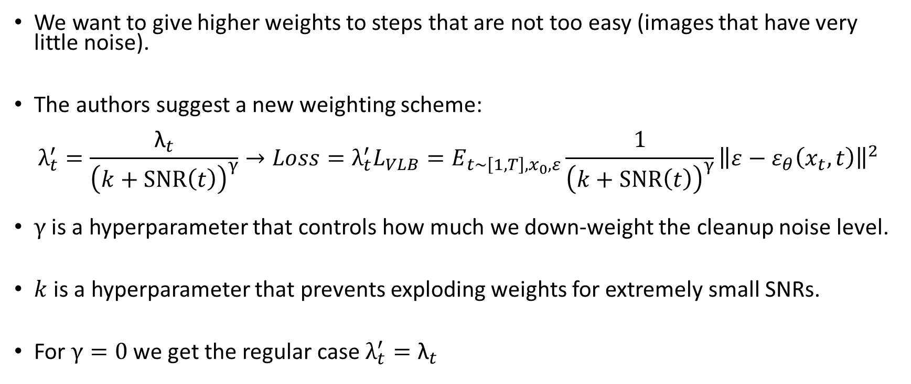
P2 Loss - Perception Prioritized Weighting
We want to give higher weights to steps that are not too easy (images that have very little noise).
The authors suggest a new weighting scheme:
$$λ_{t}^{′}=\frac{{\text{λ}}_{t}}{{\left(k+SNR\left(t\right)\right)}^{γ}}→Loss={λ_{t}^{′}L}_{VLB}=E_{{t\sim \left[1,T\right],x}_{0},ε}{\frac{1}{{\left(k+SNR\left(t\right)\right)}^{γ}}\left\|ε−ε_{θ}\left(x_{t},t\right)\right\|}^{2}$$
$γ$ is a hyperparameter that controls how much we down-weight the cleanup noise level.
$k$ is a hyperparameter that prevents exploding weights for extremely small SNRs.
For $γ=0$ we get the regular case $λ_{t}^{′}={\text{λ}}_{t}$

Slide 29
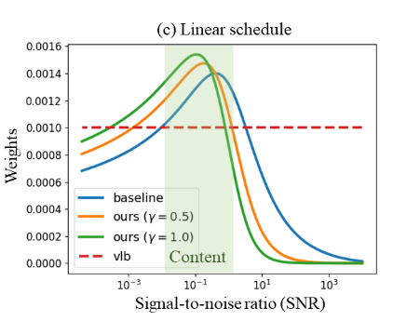
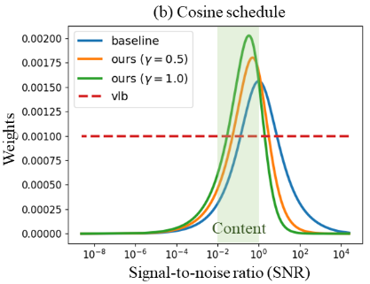
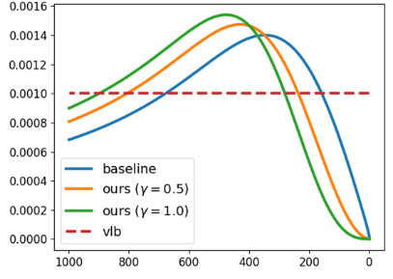
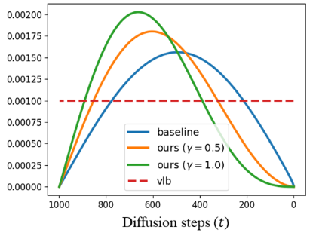
P2 Loss - Perception Prioritized Weighting
Notes:
1. Weights axis represent the values of lambda_t’ (baseline is y=0), vlb is when lambda is equal to 1

Slide 30
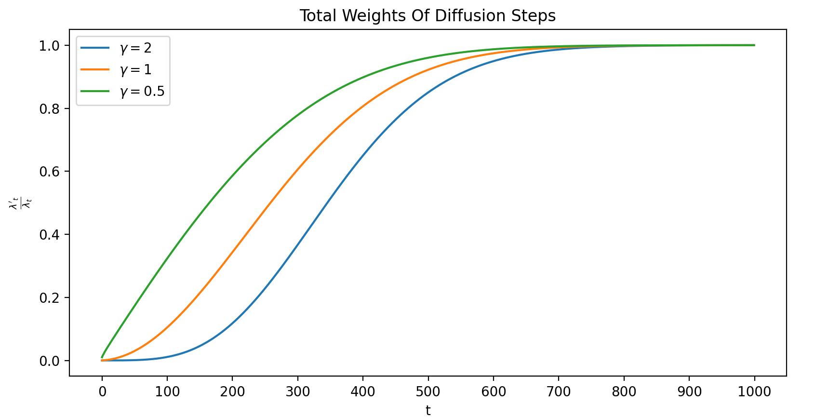
P2 Loss - Perception Prioritized Weighting
Not in paper
Notes:
1. I implemented this plot with a linear noise schedule from 1e-4 to 0.02 (same as Ho et al.) with different values of gamma
2. The authors use gamma=1, for gamma=2 they get artifacts in the samples because too much of the cleanup stage is zeroed out.

Slide 31
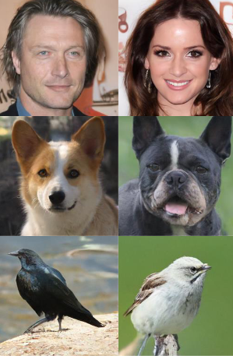
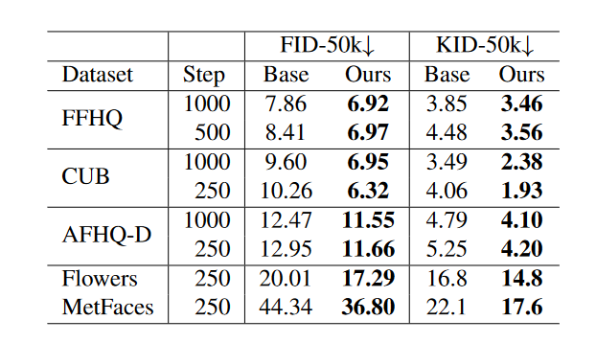
Results – Image quality
Notes:
Trained with 1k steps, sampled with 1000/500/250 steps
All methods trained the same duration (same number of gradient steps)

Slide 32
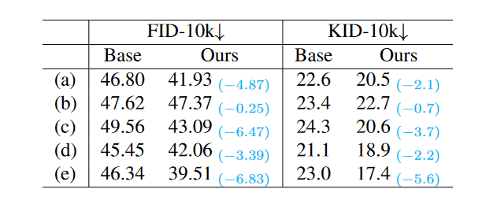
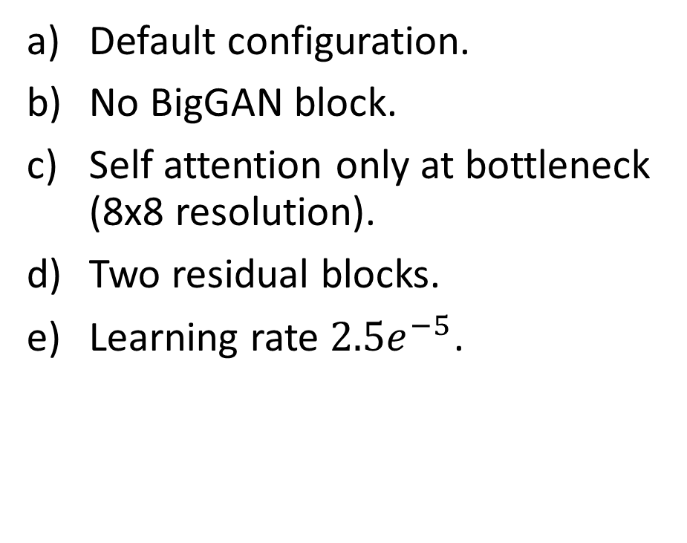
Results – Robust to Model Architecture
Default configuration.
No BigGAN block.
Self attention only at bottleneck (8x8 resolution).
Two residual blocks.
Learning rate ${2.5e}^{−5}$.
Notes:
They base their architecture on the work of “Diffusion Models Beat GANs on Image Synthesis”
All samples generated with 250 steps on ? (they don’t specify what dataset)

Slide 33
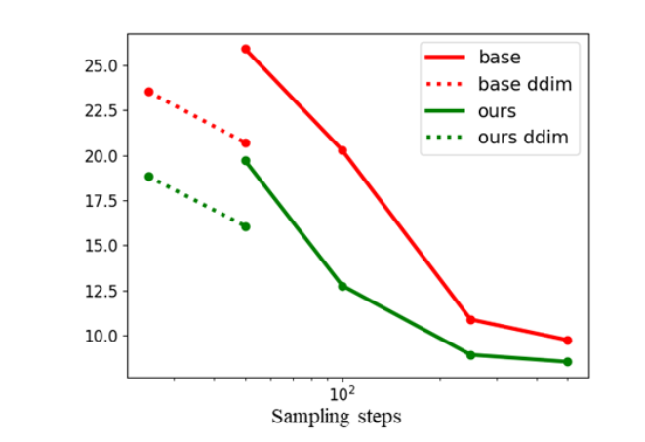
Results – Sampling Efficiency
They tested the quality of generated images when the number of sampling steps is limited.
They also demonstrated that the DDIM sampler works well with their training scheme.
Notes:
1. Plot is FID as function of sampling steps for FFHQ

Slide 34
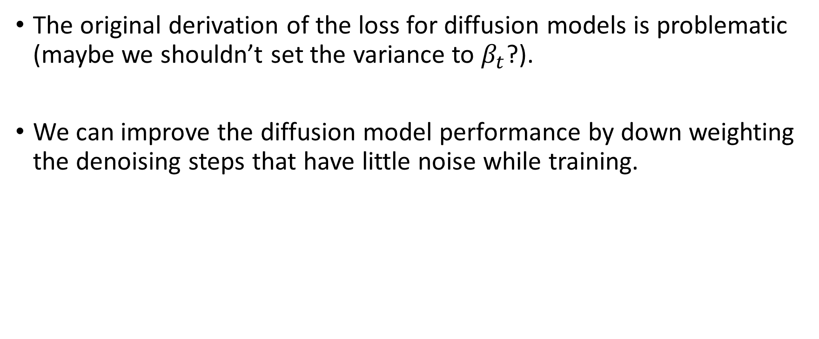
Personal Insights
The original derivation of the loss for diffusion models is problematic (maybe we shouldn’t set the variance to $β_{t}$?).
We can improve the diffusion model performance by down weighting the denoising steps that have little noise while training.
Notes:
1. For point 3 go back to qualitative experiment – hypothesis 2 and look that for a long period the noisy image look the same.

Slide 35
Questions?

Slide 36
An Efficient Noise Aware Training Scheme For Diffusion Models
This project objectives:
Introduce a hypothesis that can be leveraged to improve the loss function in "Perception Prioritized Training of Diffusion Models".
Propose a new simple method that will speed up the training of diffusion models.

Slide 37
Noise Sensitivity
Hypothesis:
Depending on the content of the image, a similar noise can lead to varying levels of degradation in the perceptual quality of the image.
This degradation is sensitive even to images with contents that have similar semantic meaning (i.e. images of objects from the same class).
We perform qualitative and quantitative experiments to support our hypothesis.

Slide 38
Qualitative Experiment
Notes:
Linear schedule between 1e-4 to 0.02 in 1000 steps
Top row is an image in resolution 64x64, all other rows are image in resolution 256x256

Slide 39
Quantitative Experiments
We perform 2 experiments:
We measure the importance of the content in an image by applying the same noise (same noise for each t=[0, 500]) to 200 images, and then measure the degradation in image quality by calculating the LPIPS between the original and noisy image.
We test whether the specific noise we used in experiment 1 had a significant impact on the results. To do this, we use various gaussian noises for each t=[0, 500] and apply them to 1 random image. We check how consistent the LPIPS is for each time step.
Notes:
Experiment 2 tests that the specific noise we chose for experiment 1 did not cause the variance of degradation. We try to show here that regardless of the specific gaussian noise chosen, the LPIPS between the original and noisy image will not vary – this way we can assume that each data point in experiment 1 would stay more or less the same even if we have used a different sampled gaussian noise for all the images

Slide 40
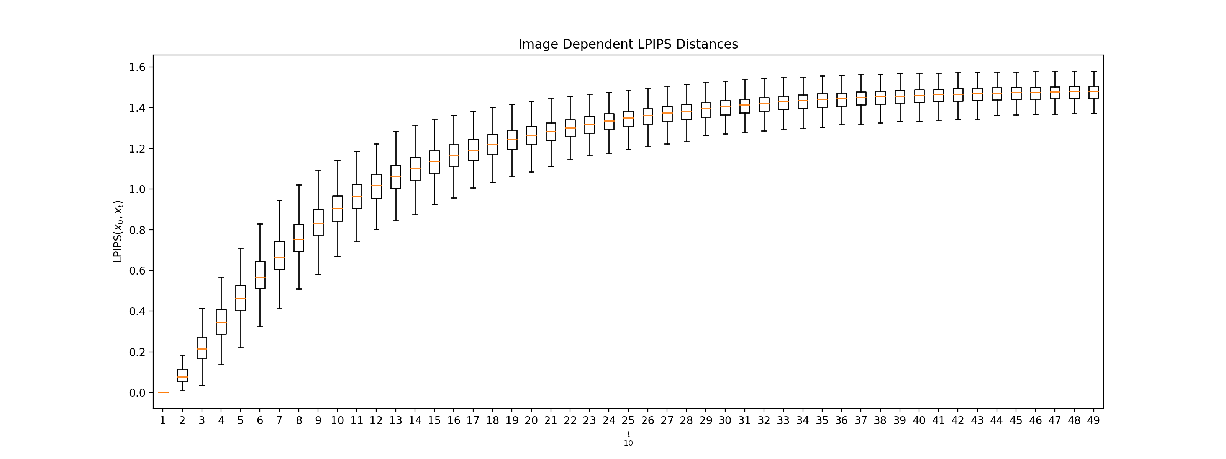
Experiment 1
Notes:
Used 200 images from flowers102 dataset, and sampled once noises for all t in [0, 500] and used the same noises for all images.
If the LPIP values vary a lot, we can conclude that the content of the image affects how sensitive it is to degradation in perceptual quality due to noise.

Slide 41
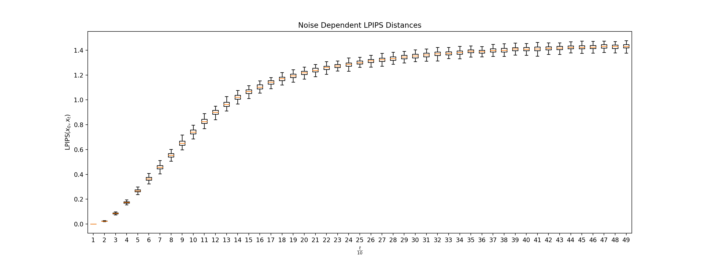
Experiment 2
Notes:
1. Used 1 image from flowers102 dataset, and sampled 200 different noises for each t in [0, 500] and used these noises on the same image.
2. If the LPIPS values are consistent across all the time steps, we can conclude that the specific noise we used in experiment 1 didn't significantly affect the results.

Slide 42
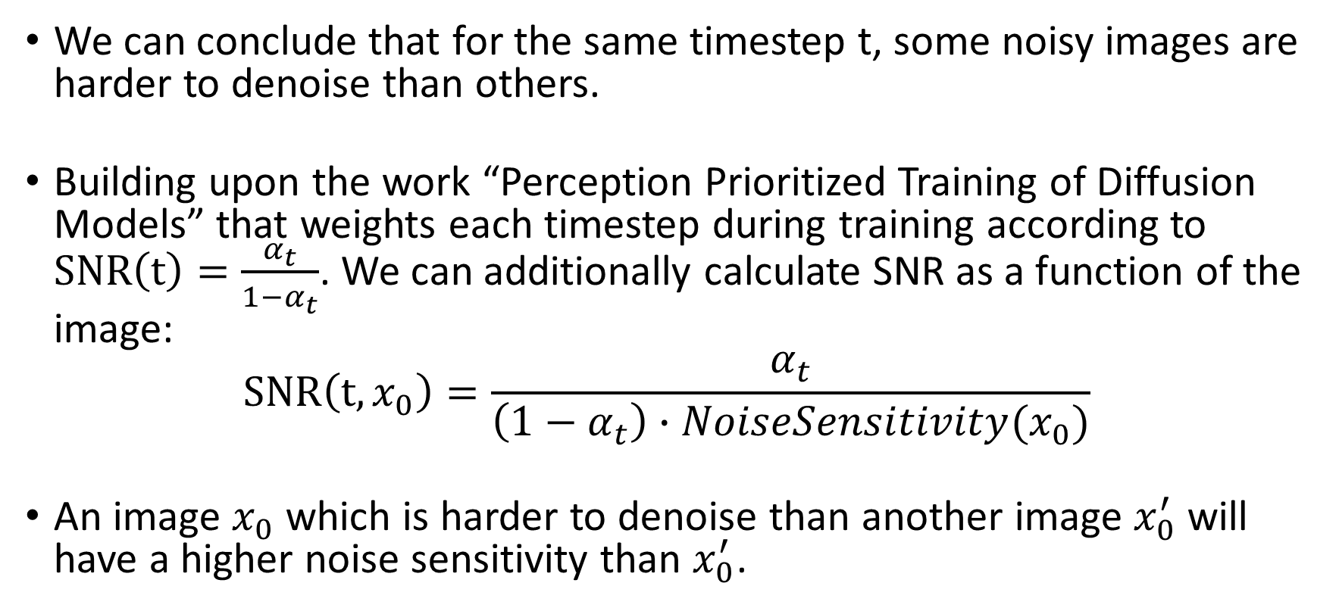
Insights From The Hypothesis
We can conclude that for the same timestep t, some noisy images are harder to denoise than others.
Building upon the work “Perception Prioritized Training of Diffusion Models” that weights each timestep during training according to $SNR\left(t\right)=\frac{α_{t}}{1−α_{t}}$. We can additionally calculate SNR as a function of the image:
$$SNR\left(t,x_{0}\right)=\frac{α_{t}}{\left(1−α_{t}\right)∙NoiseSensitivity(x_{0})}$$
An image $x_{0}$ which is harder to denoise than another image $x_{0}^{′}$ will have a higher noise sensitivity than $x_{0}^{′}$.
Notes:
1. In practice we can approximate this “noise sensitivity” for each image before training (as a pre-processing step) by check its average LPIPS for ranges of different timesteps. By doing so, the training time should not be significantly affected.

Slide 43
Efficient Training
In “Perception Prioritized Training of Diffusion Models” we give lower weights to time steps with small values of t in the loss function.
However, this is inefficient. Instead of weighting the loss function I propose to instead weight the sampling of t.
The probability of sampling t will be proportional to their weight we would have given them with P2 loss. Essentially, we will under sample the small values of t during training.

Slide 44
Experimental Setup
Two datasets were used:
Oxford Flowers 102 (~8k images)
FFHQ (~50k images)
All the images were resized to a resolution of 128x128 to save computational resources.
The model has a similar architecture to the one used in “Perception Prioritized Training of Diffusion Models”. However, the model has 2 Resnet blocks in each level of the U-Net instead of 1 (the model has around 45M parameters).
Notes:
1. A big batch size is critical when you downsample t!

Slide 45
Experimental Setup
Except for using a batch size of 256 and FP16, all training hyperparameters are identical to what was used in “Perception Prioritized Training of Diffusion Models”.
For evaluation, after each 10k iterations a checkpoint of the models is saved. The checkpoint is then used for generating 10k samples which are used for calculating the FID with the train set.

Slide 46
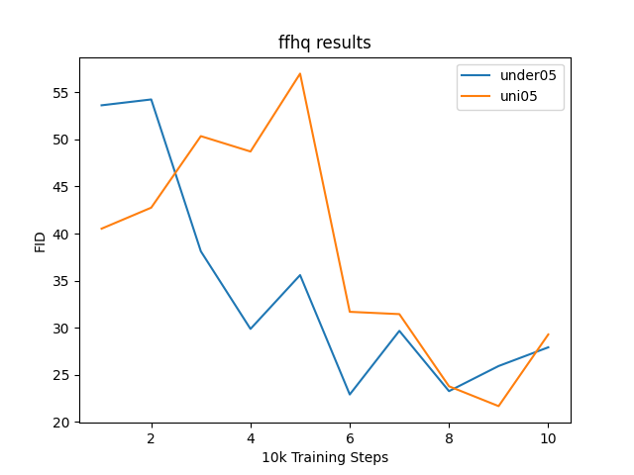
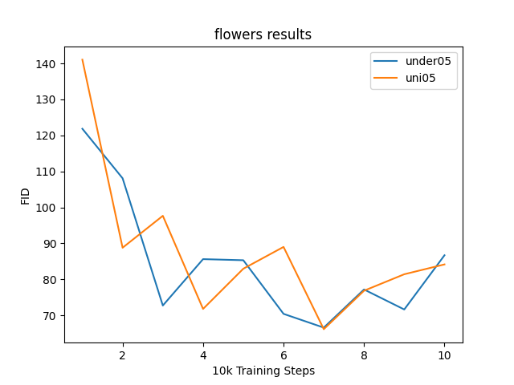
Results

Slide 47




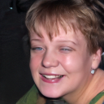
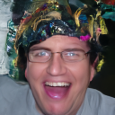
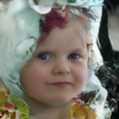













Results

